Slide 1
Central Texas Iris Society
Virtual Iris Show
Saturday, April 18, 2020

Slide 2
Division I – Horticulture
Section A – Tall Bearded

Slide 3
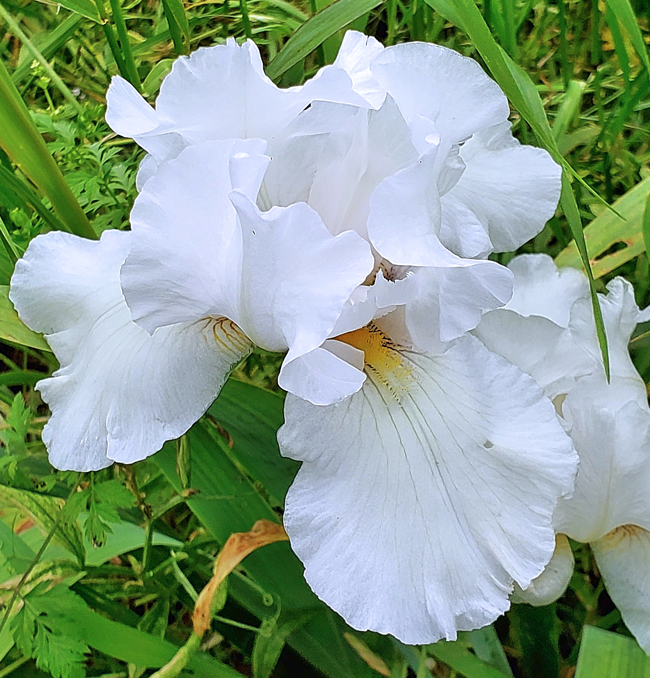
‘Arctic Express’ (Gatty, 1996) - Karen Woods

Slide 4
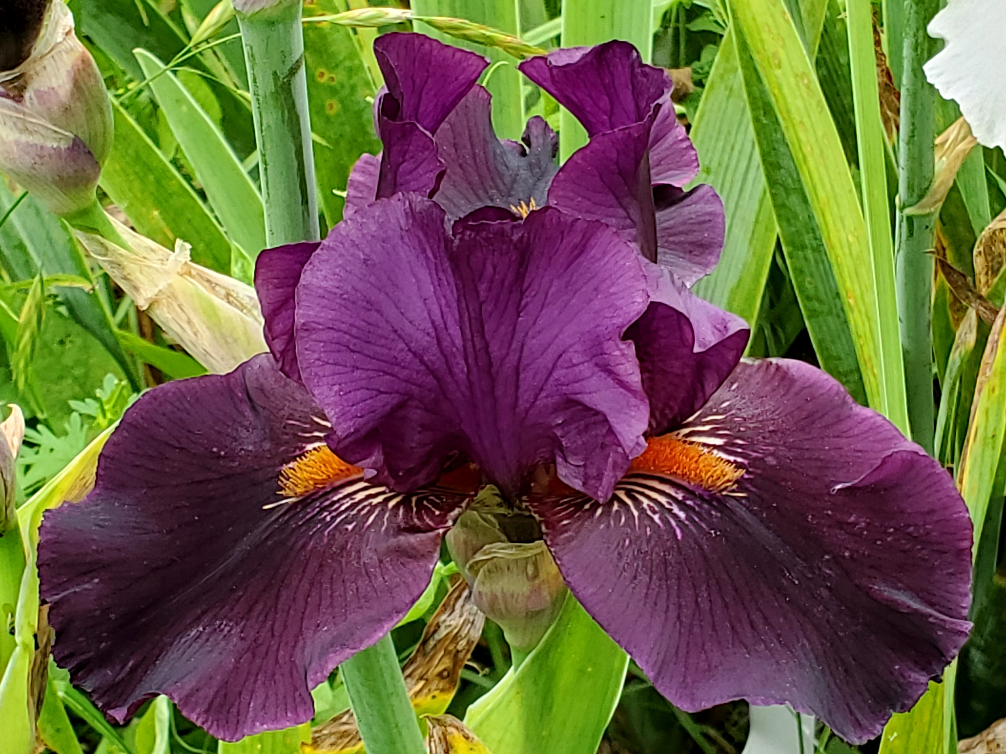
‘Dracula's Kiss’ (Schreiner, 2009) - Karen Woods

Slide 5
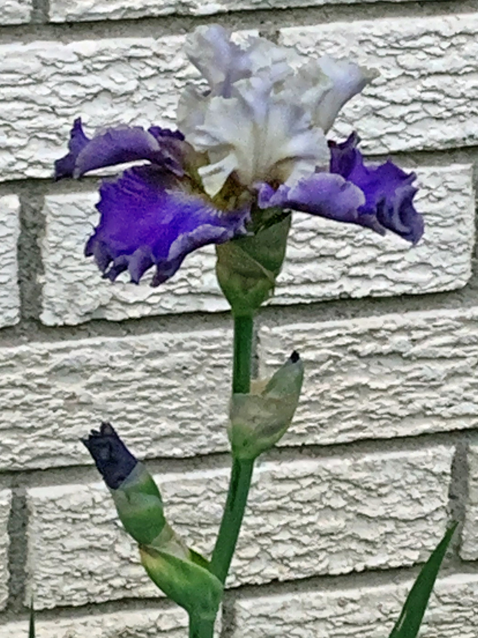
‘Gaze’ (Blyth, 2006) - Joan Erwin
s

Slide 6
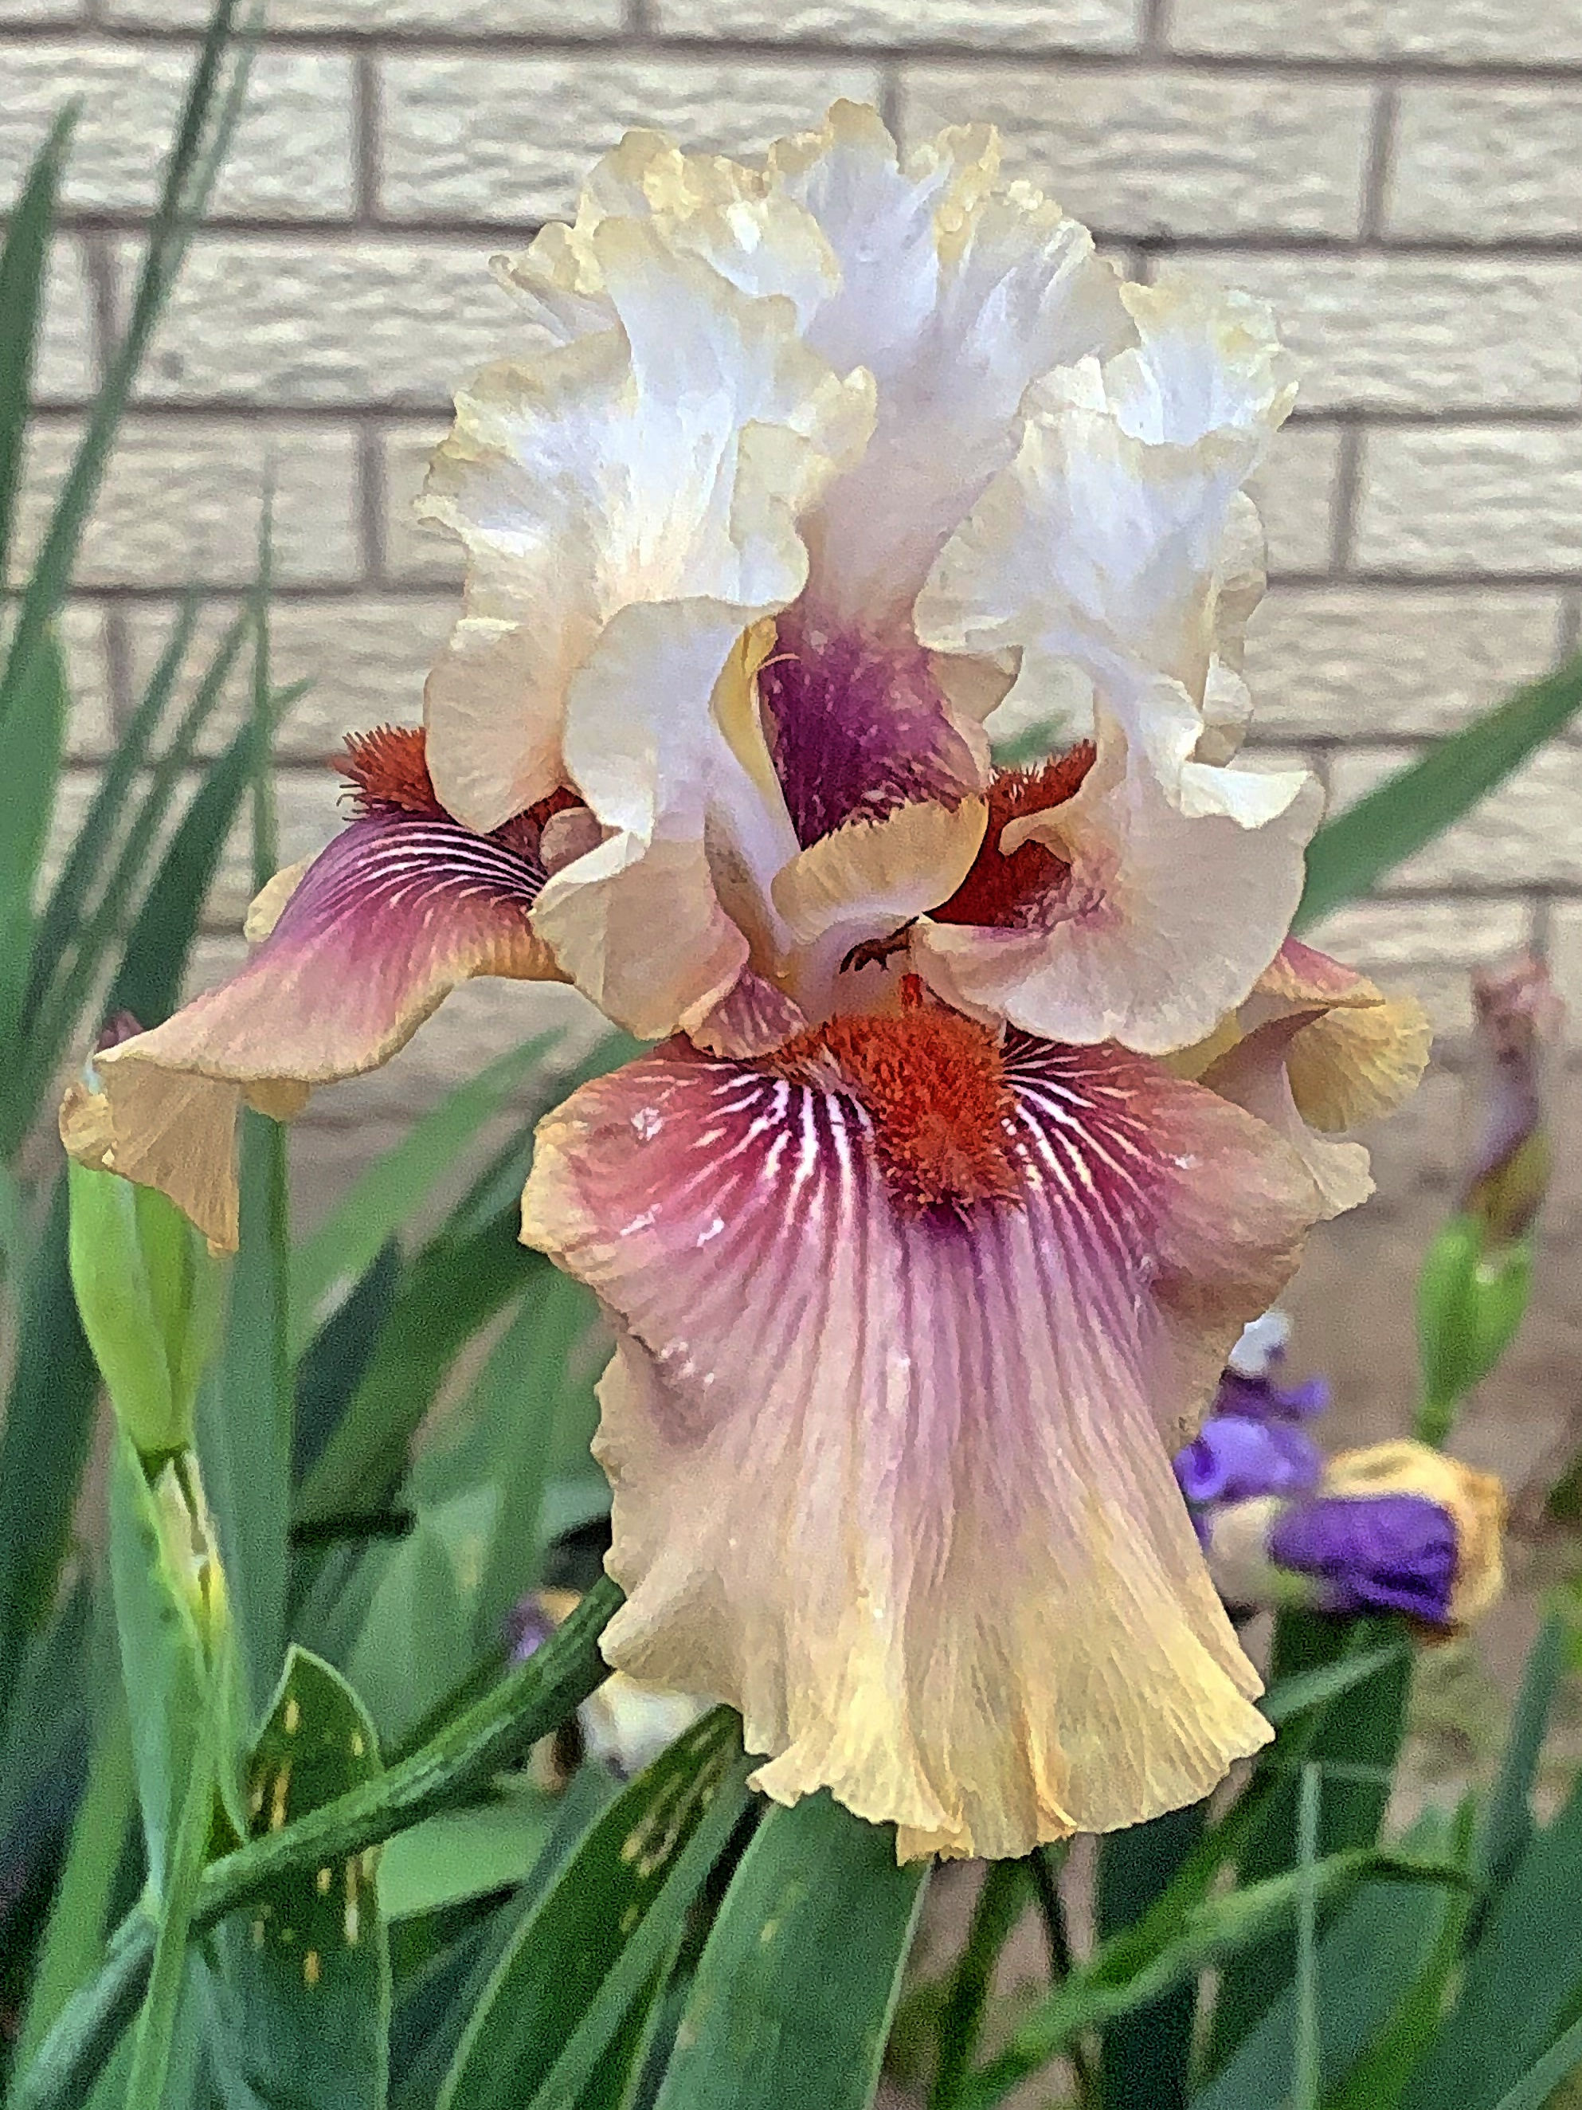
‘Have a Goodun’ (Burseen, 2006) - Joan Erwin
s

Slide 7
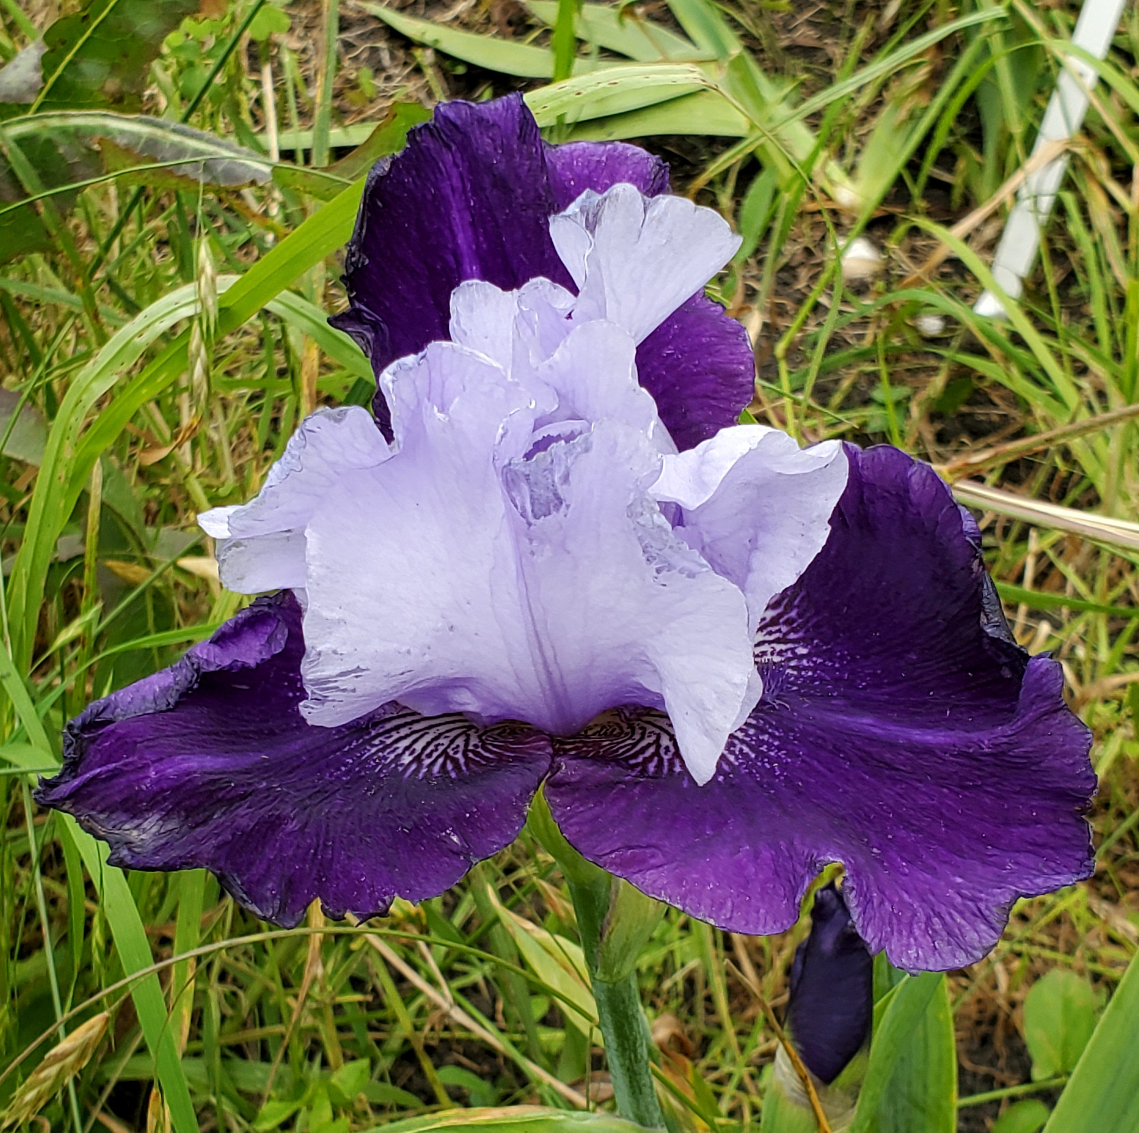
‘Midnight Cry’ (Van Liere, 2016) - Karen Woods
s

Slide 8
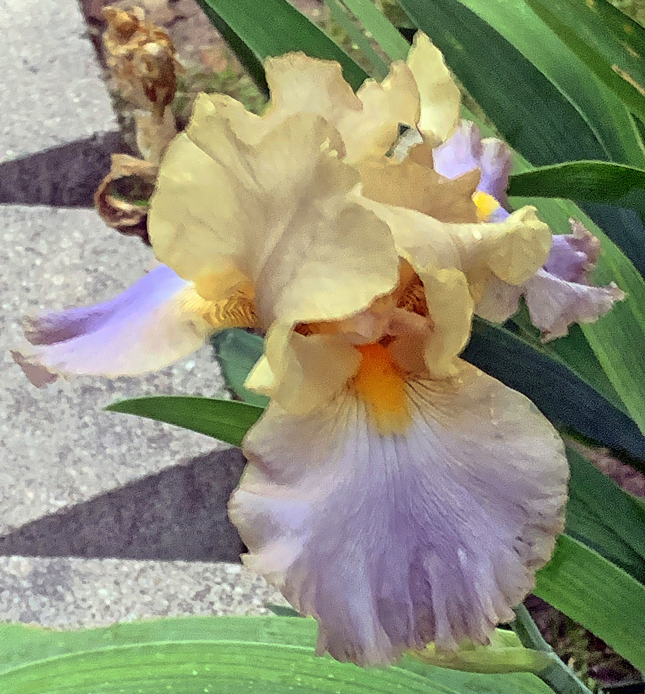
‘Obi Wan Kenobi’ (Mahan, 2002) - Joan Erwin
s

Slide 9
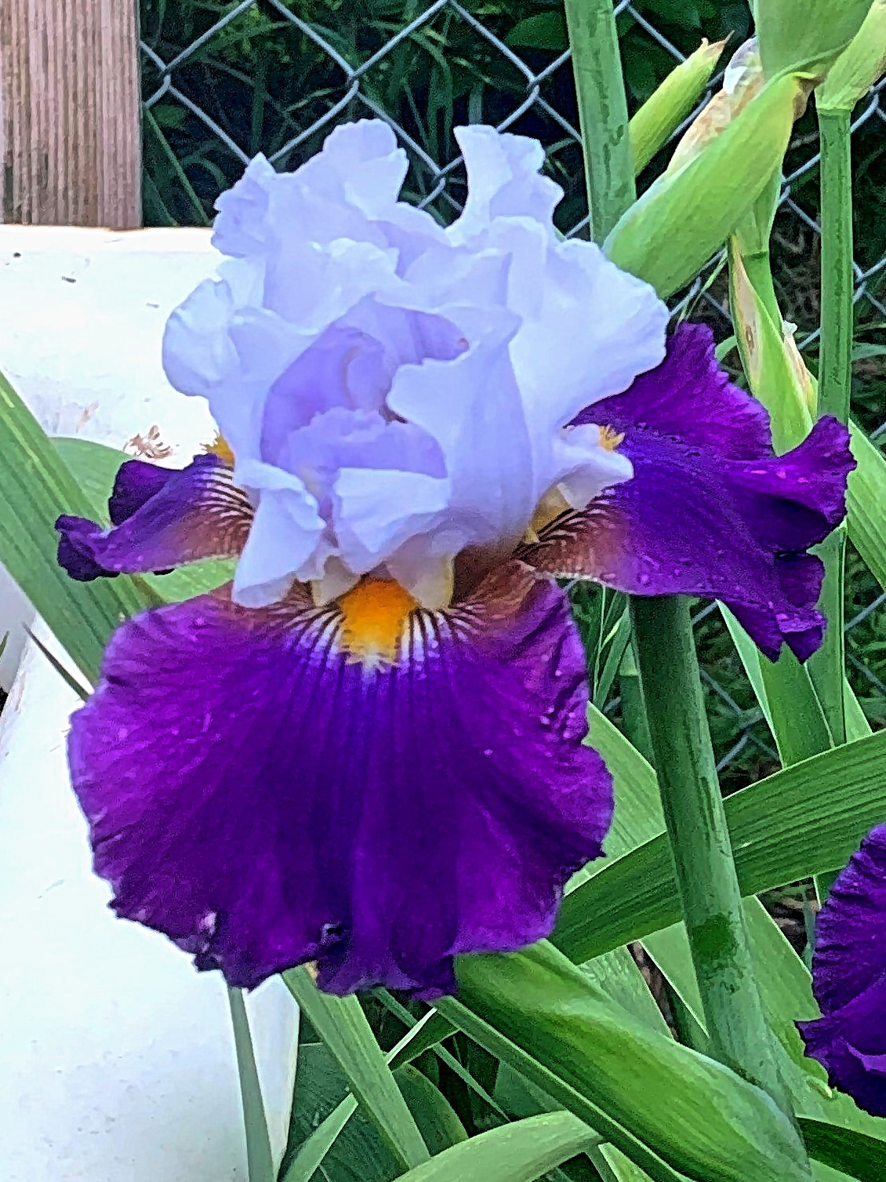
‘Seal a Deal’ (Burseen, 2015) - Joan Erwin
s

Slide 10
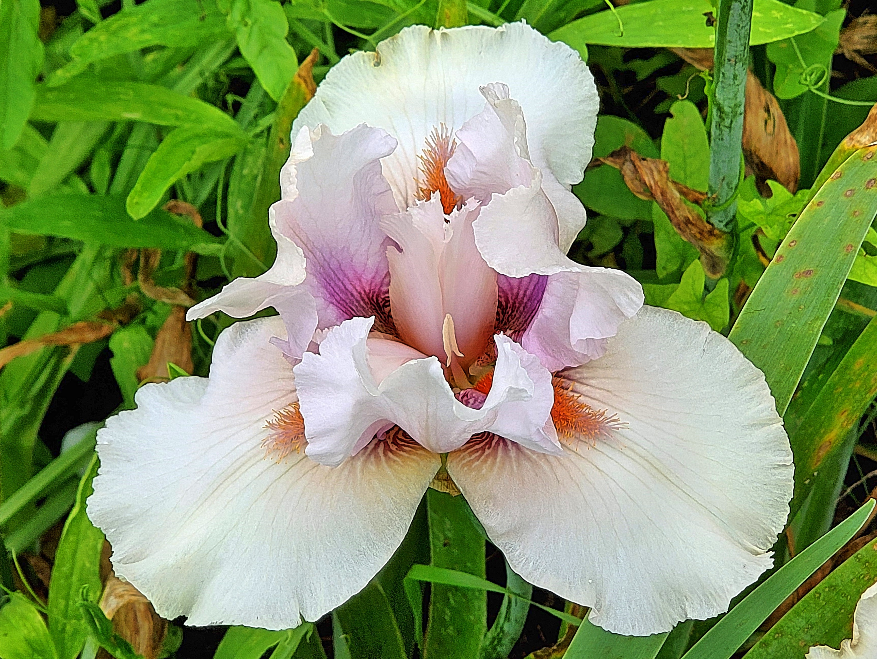
‘Spittin Cotton’ (Burseen, 2009) - Karen Woods
s

Slide 11
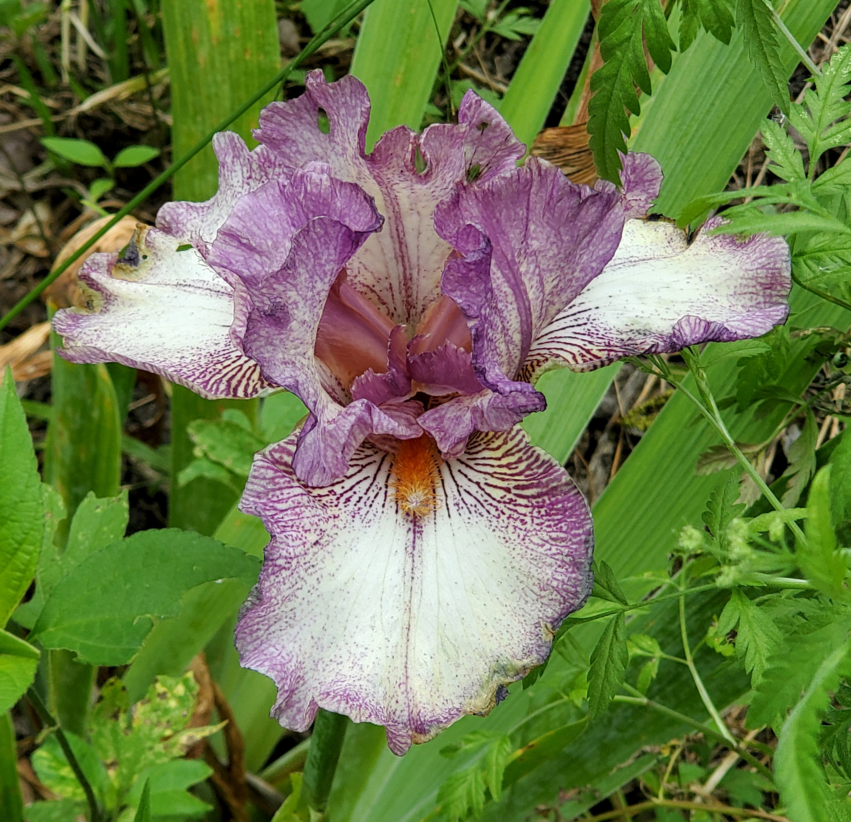
‘Tomball’ (Burseen, 2011) - Karen Woods
s

Slide 12
Division I – Horticulture
Secton D – Historic TB
(introduced before 1991)

Slide 13
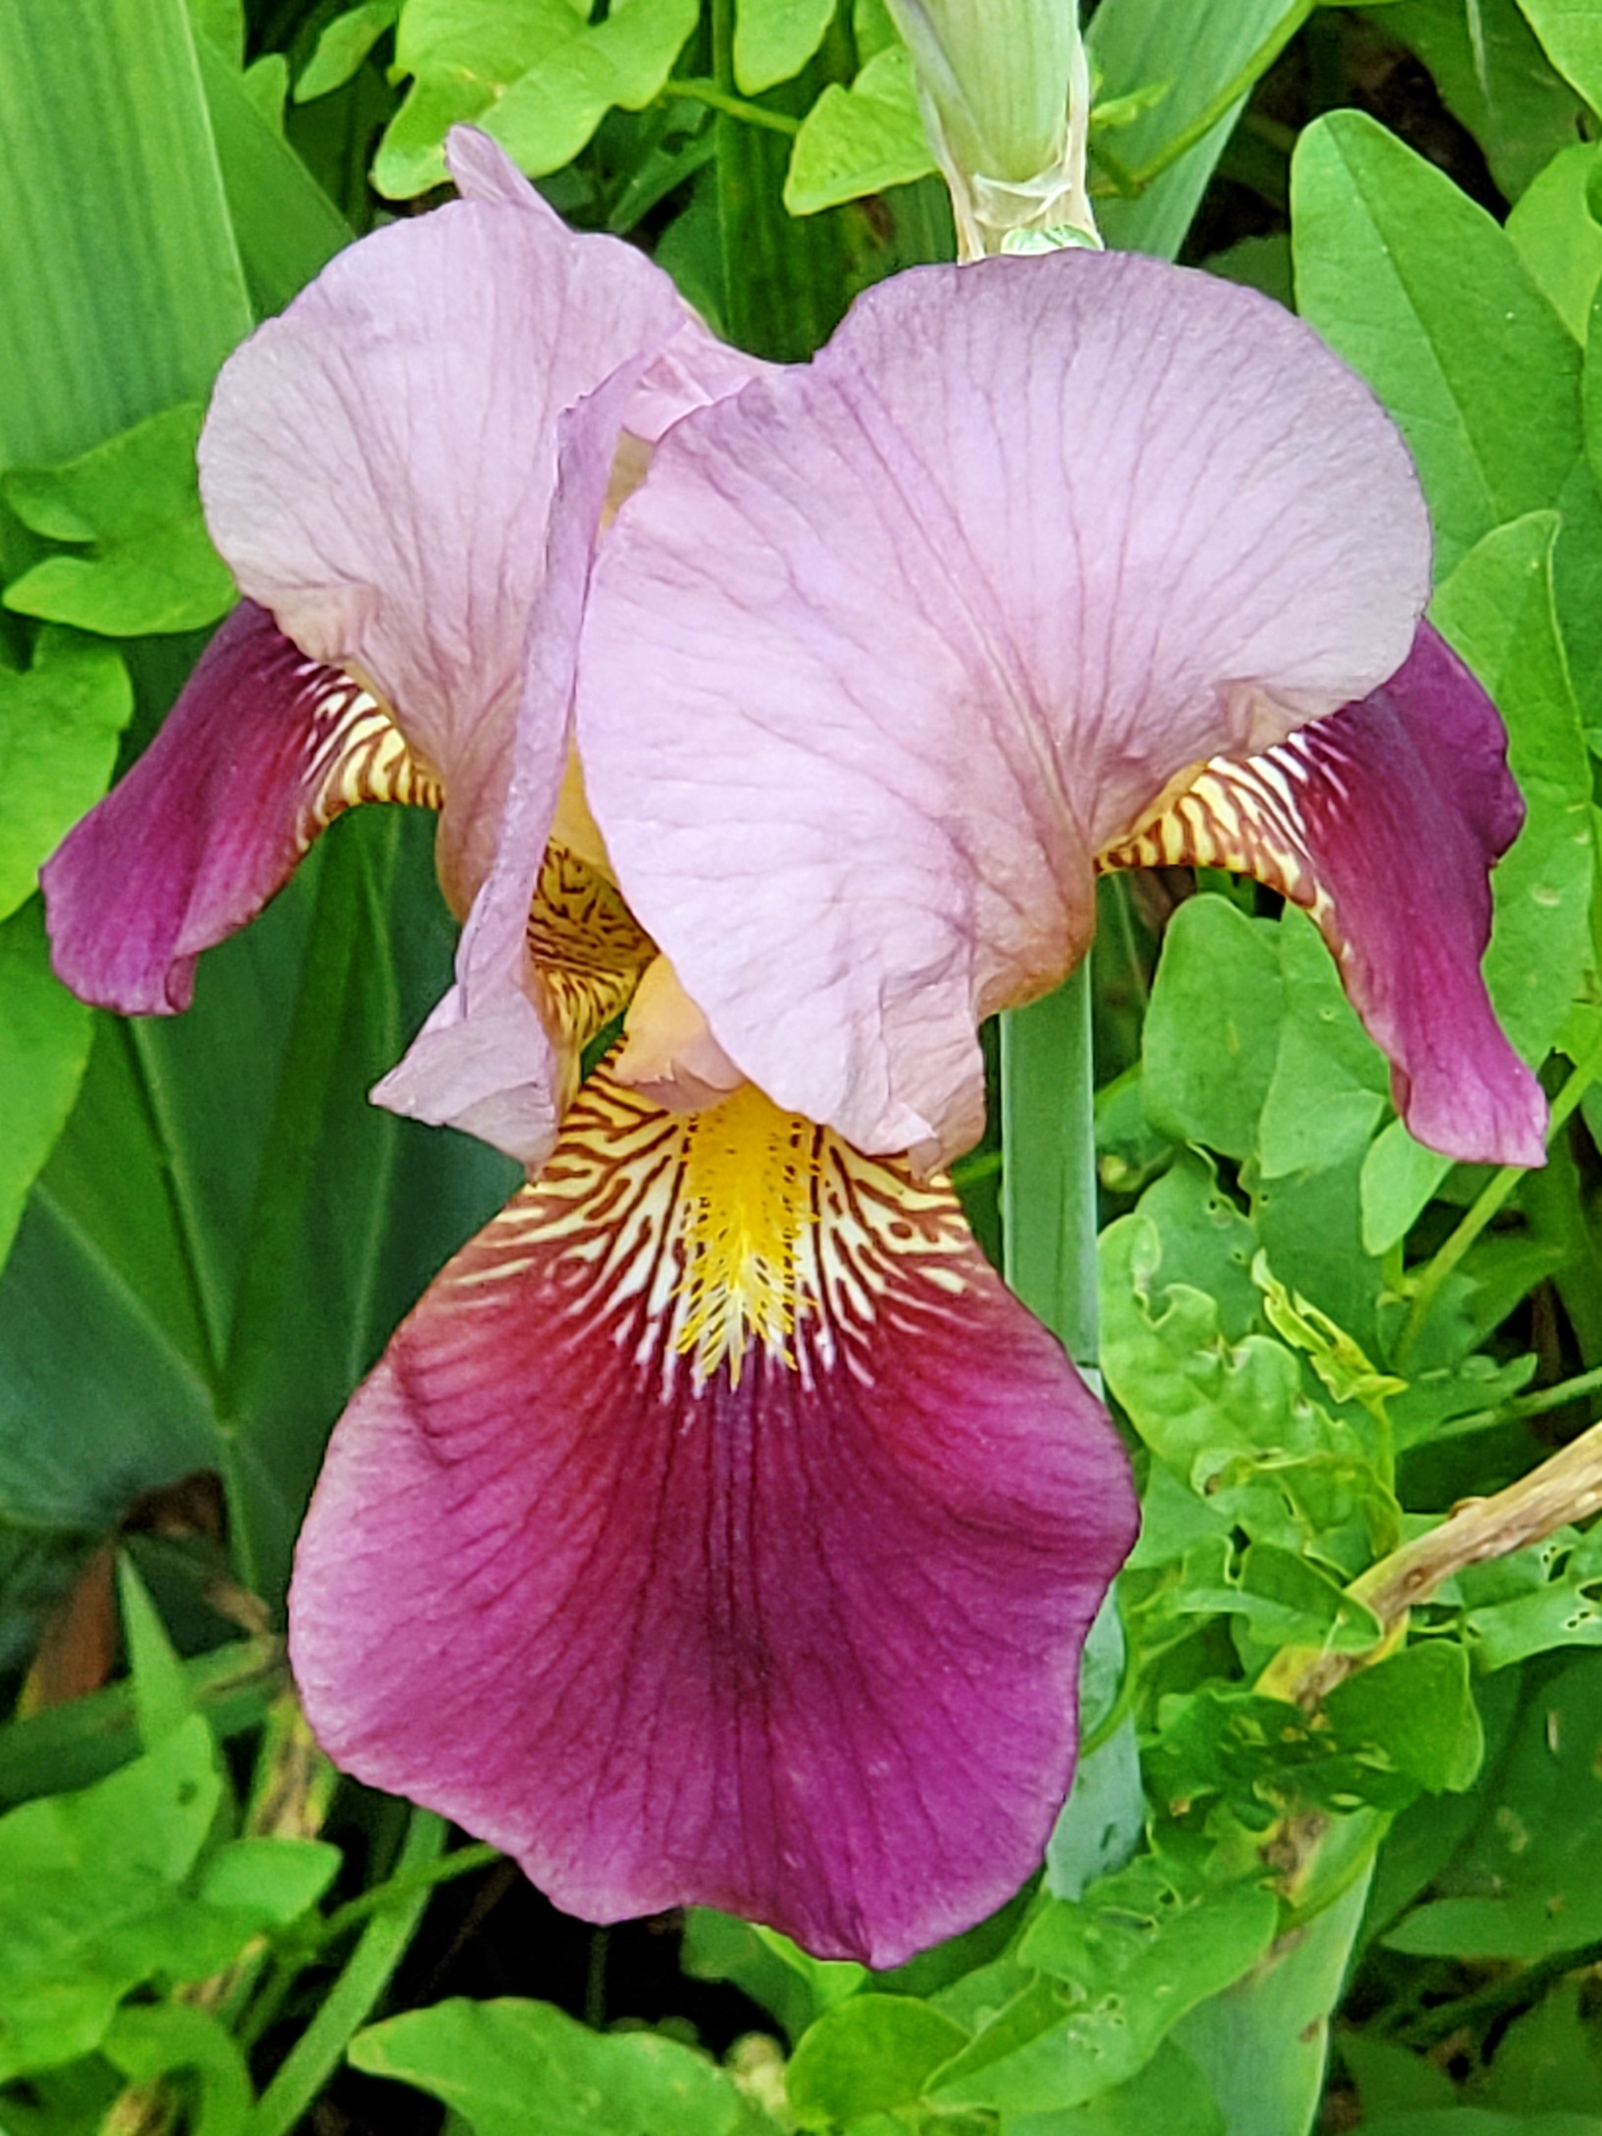
‘Alcazar’ (Vilmorin, 1910) - Karen Woods
s

Slide 14
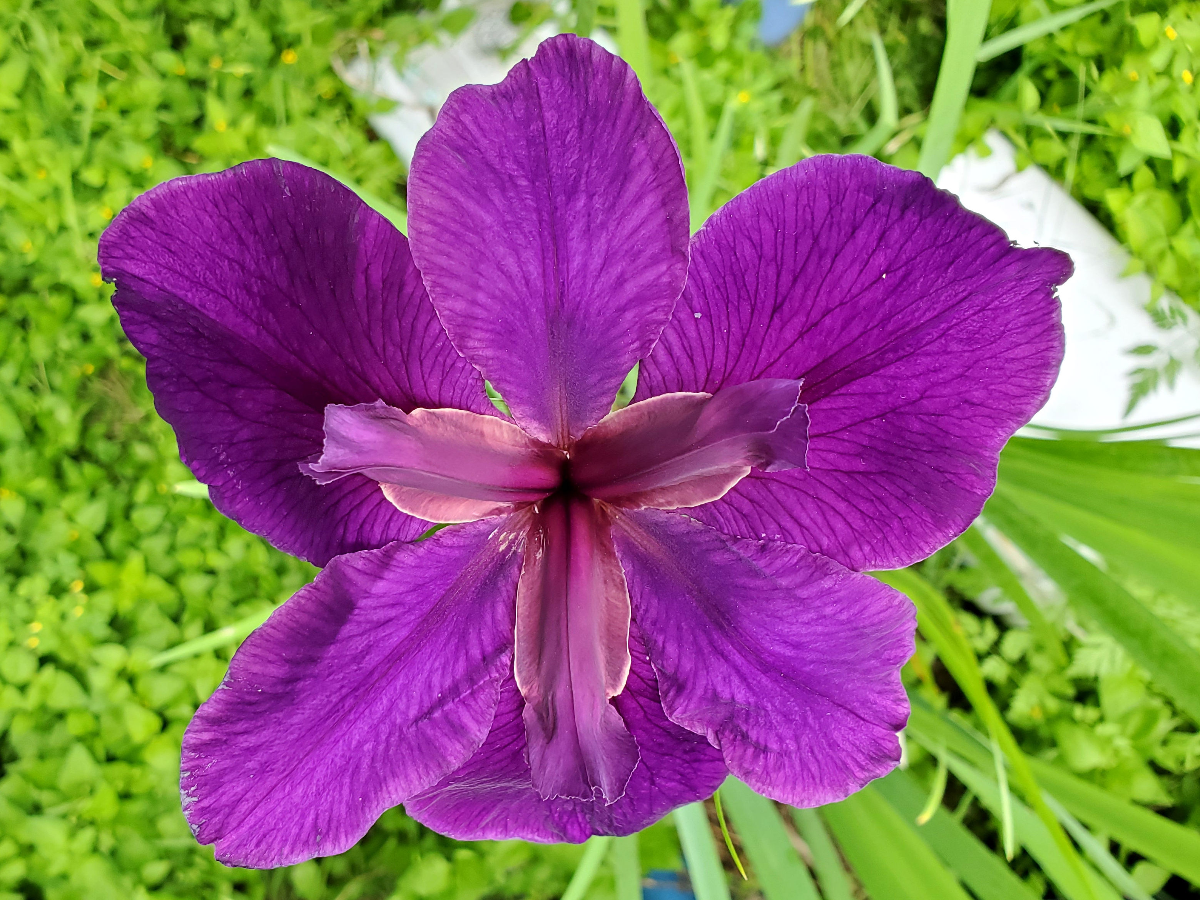
‘Jeri’ (Bertinot, 1984 LA) - Karen Woods
s

Slide 15
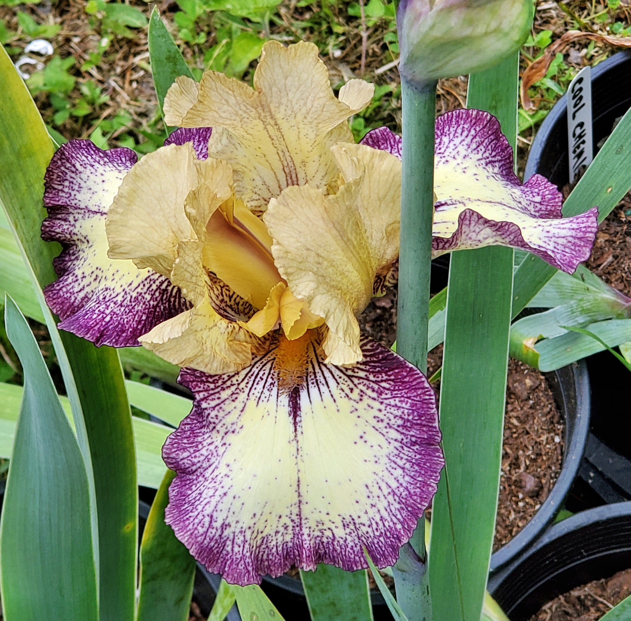
‘Point Made’ (Innerst, 1987) - Karen Woods
s

Slide 16
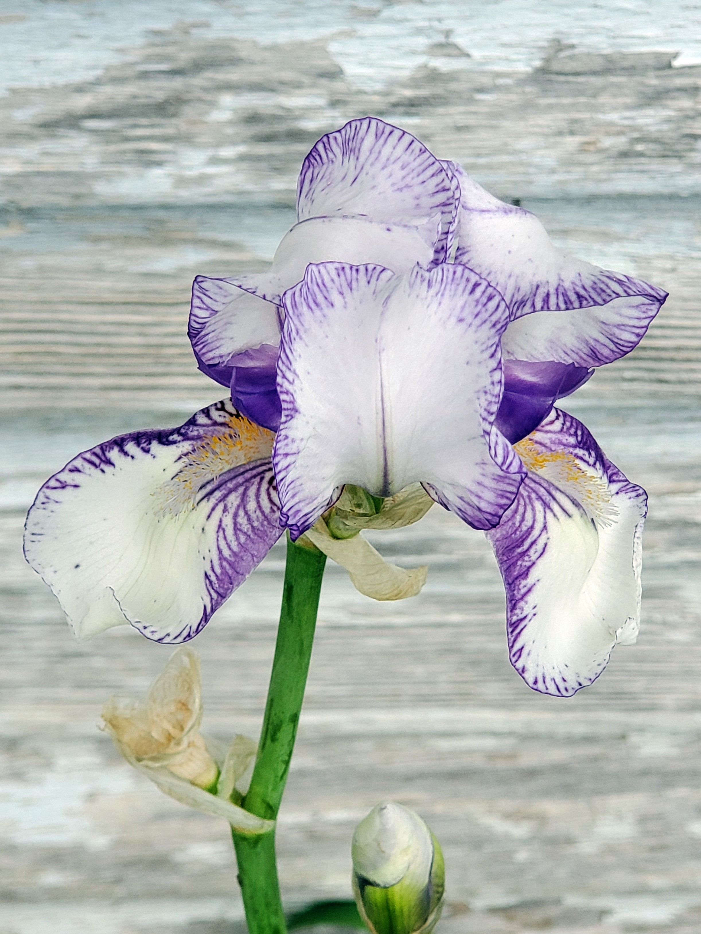
‘Swerti’ (1612 SPEC) - Karen Woods
s

Slide 17
Division I – Horticulture
Section E – All Other
Bearded (BB) (IB) (MTB)
(SDB) (MDB)

Slide 18
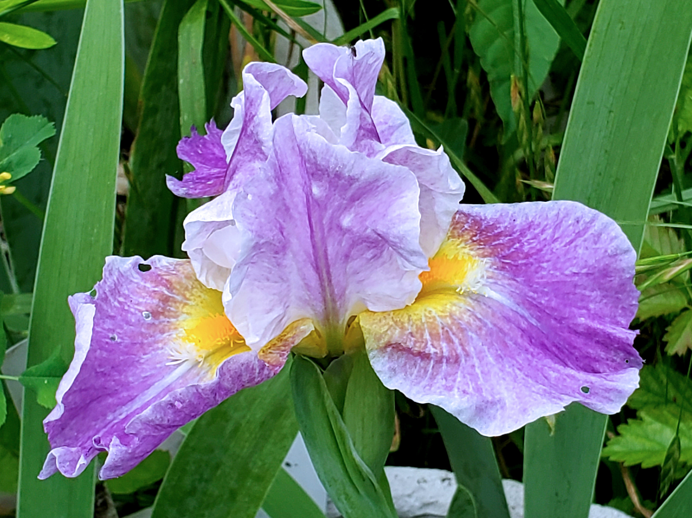
‘Backlit Beauty’ (Tasco, 2010 IB) - Karen Woods
s

